Slide 1
Background and Projects
Graham Peyton

Slide 2
Overview
Pre-PhD
PhD (2014-2017)
Butterfly (2017-2021)
EpilepsyCo / Liminal / Hyperfine (2019 – present)

Slide 3
Pre-PhD
“Double major”
Biomed (2008-2010)
EE (2011-2012) – built a pulse oximeter
MSc – computational neuroscience
Magnetoencephalography focusing on parity detection in the brain
Standard multivariate signal processing – ICA/PCA, wavelets, time-frequency, topographical mapping.
Looked at ERFs and induced fields to predict even/odd decision.
Never got into source reconstruction and inverse problems!

Slide 4
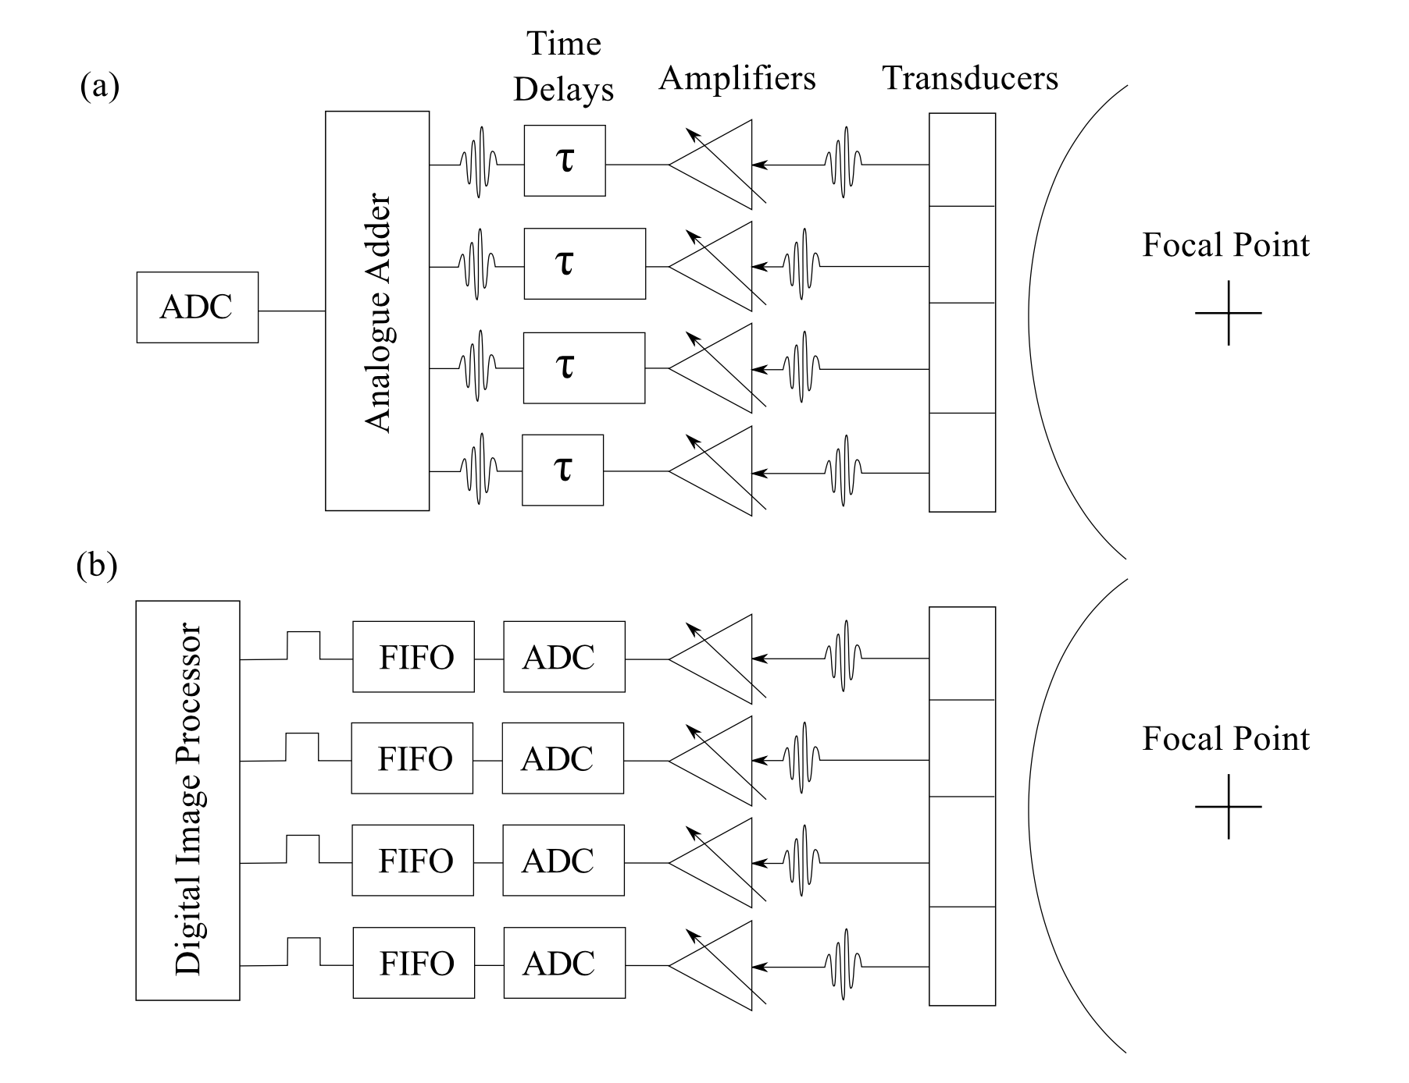
Ultrasound background

Slide 5
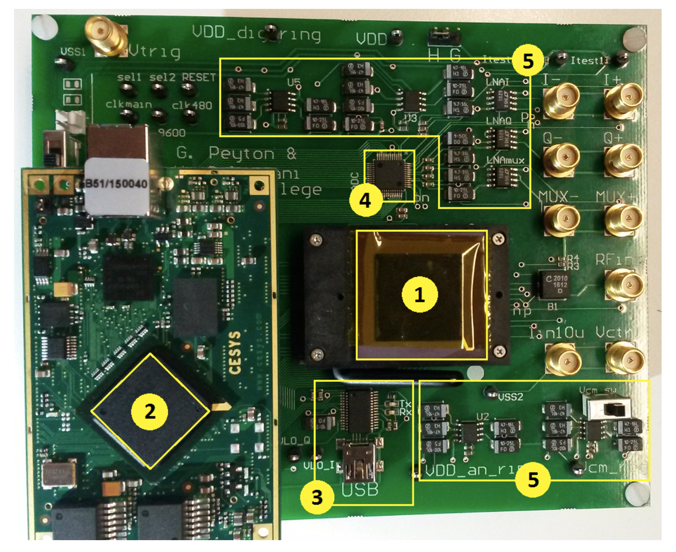
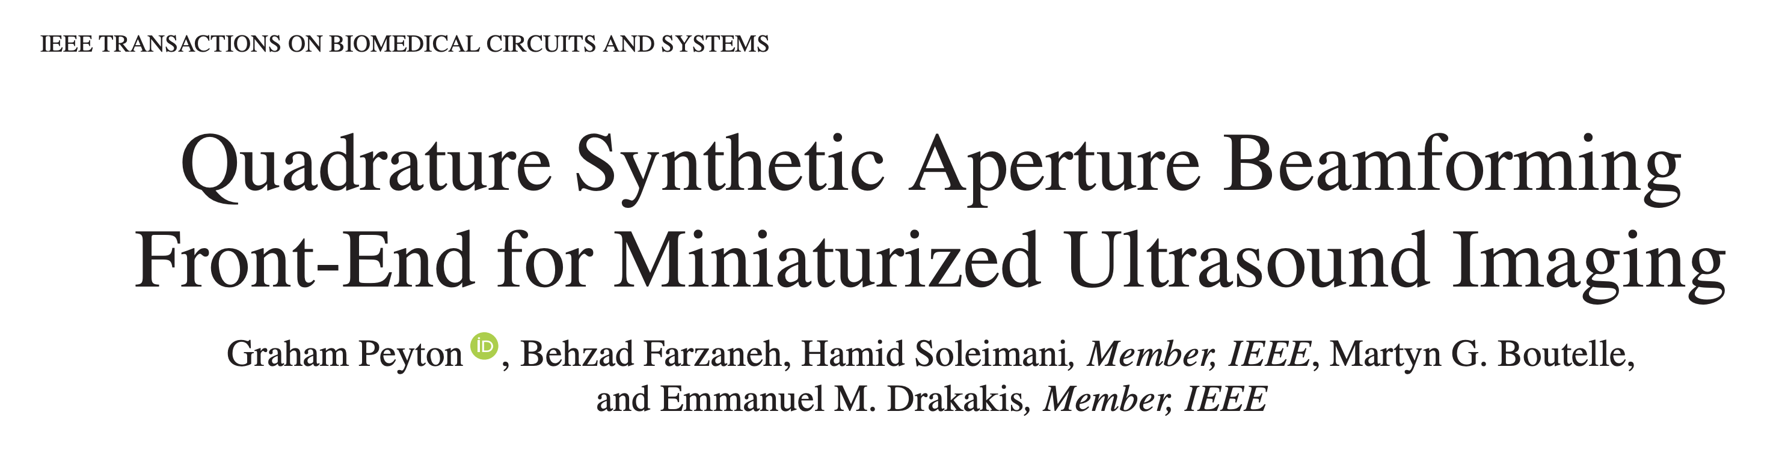
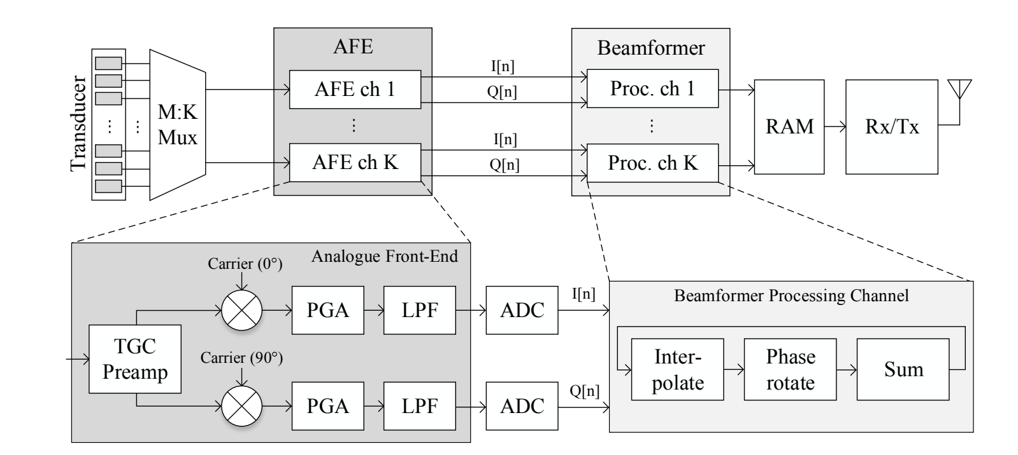
PhD @ Imperial College London
Main objectives:
Build architecture “ultra-miniaturized” ultrasound – low power for wireless
Build proof-of-concept HW, including on-chip AFE

Slide 6
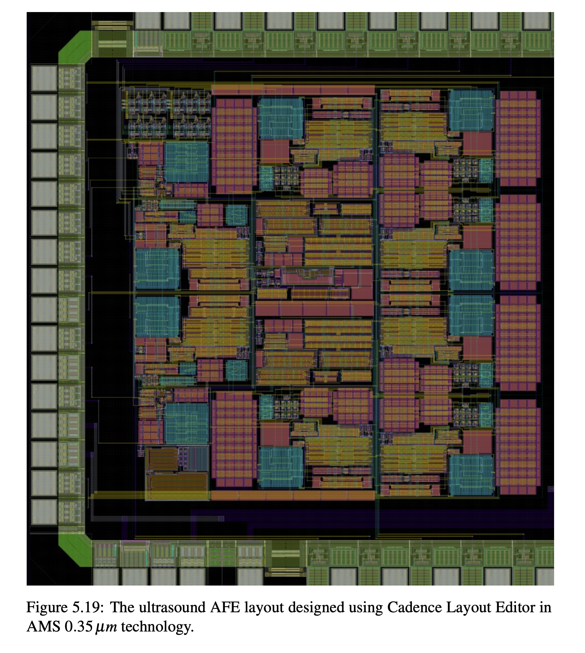
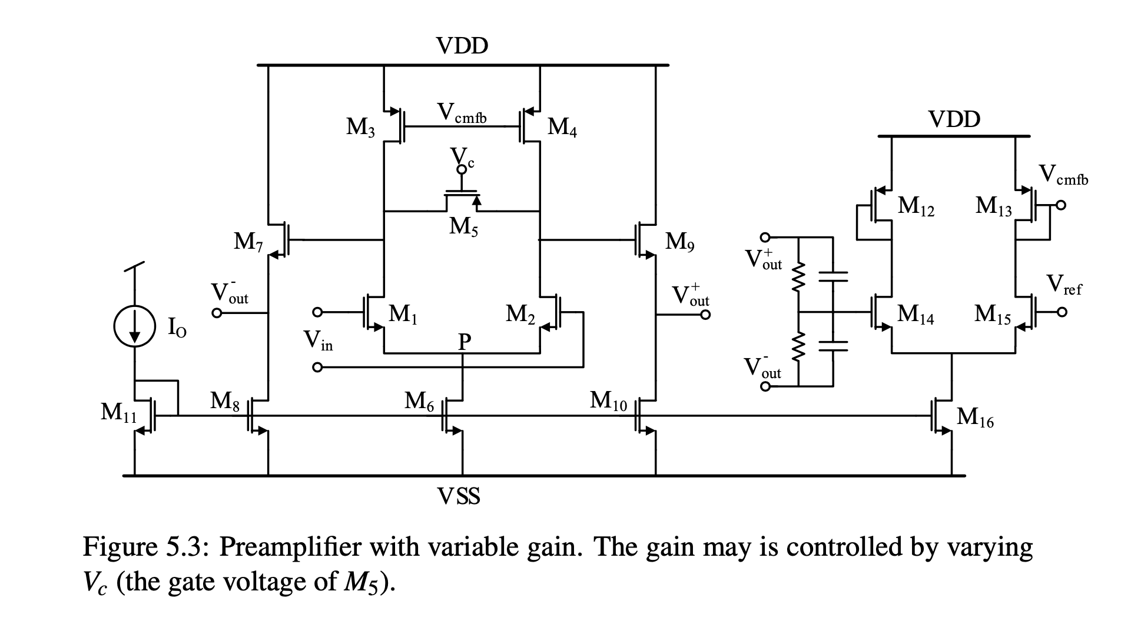
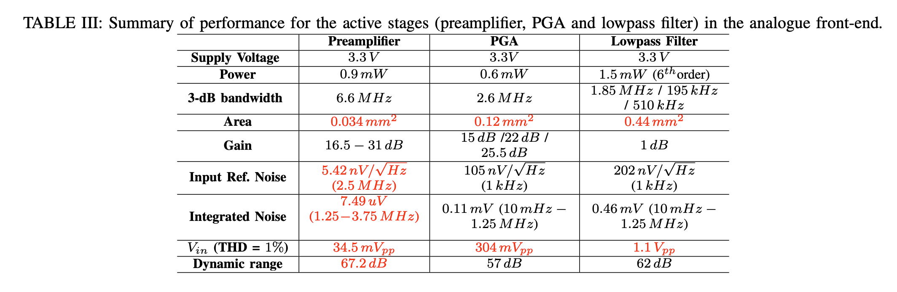
AFE in 0.35um CMOS

Slide 7
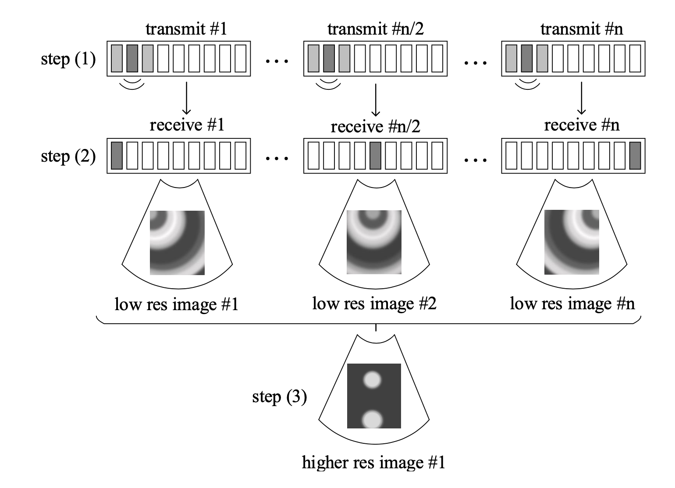
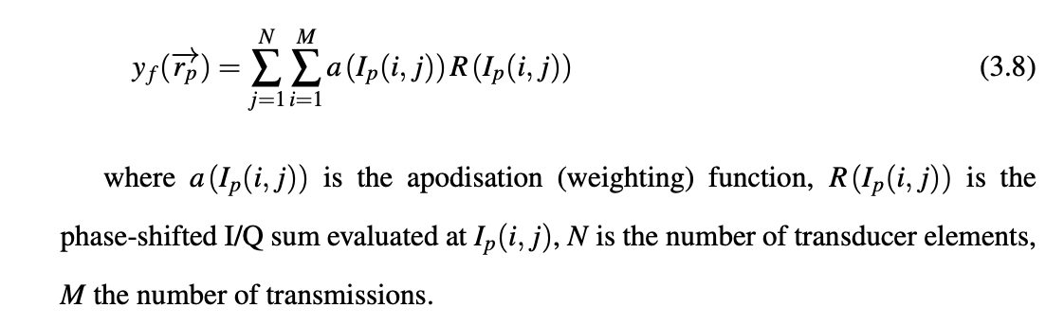
Beamformer
The beamformer is implemented on a Spartan-6 FPGA - consumes 296mW for a frame rate of 7Hz.

Slide 8
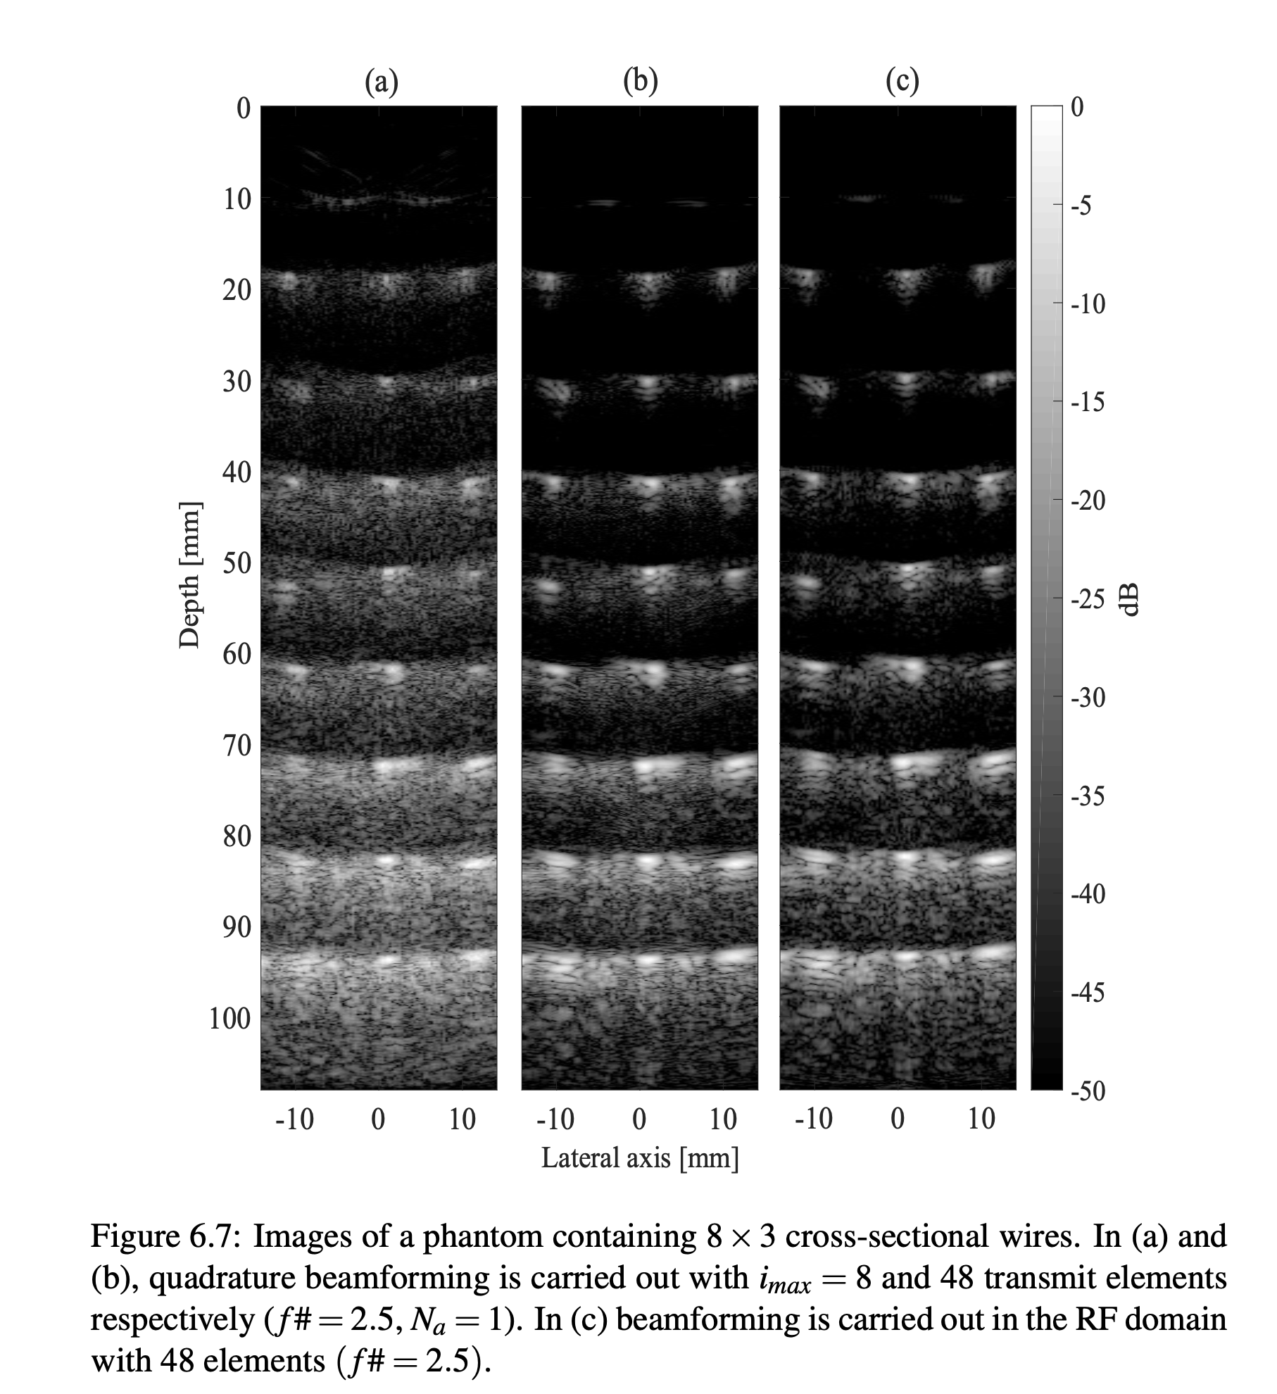
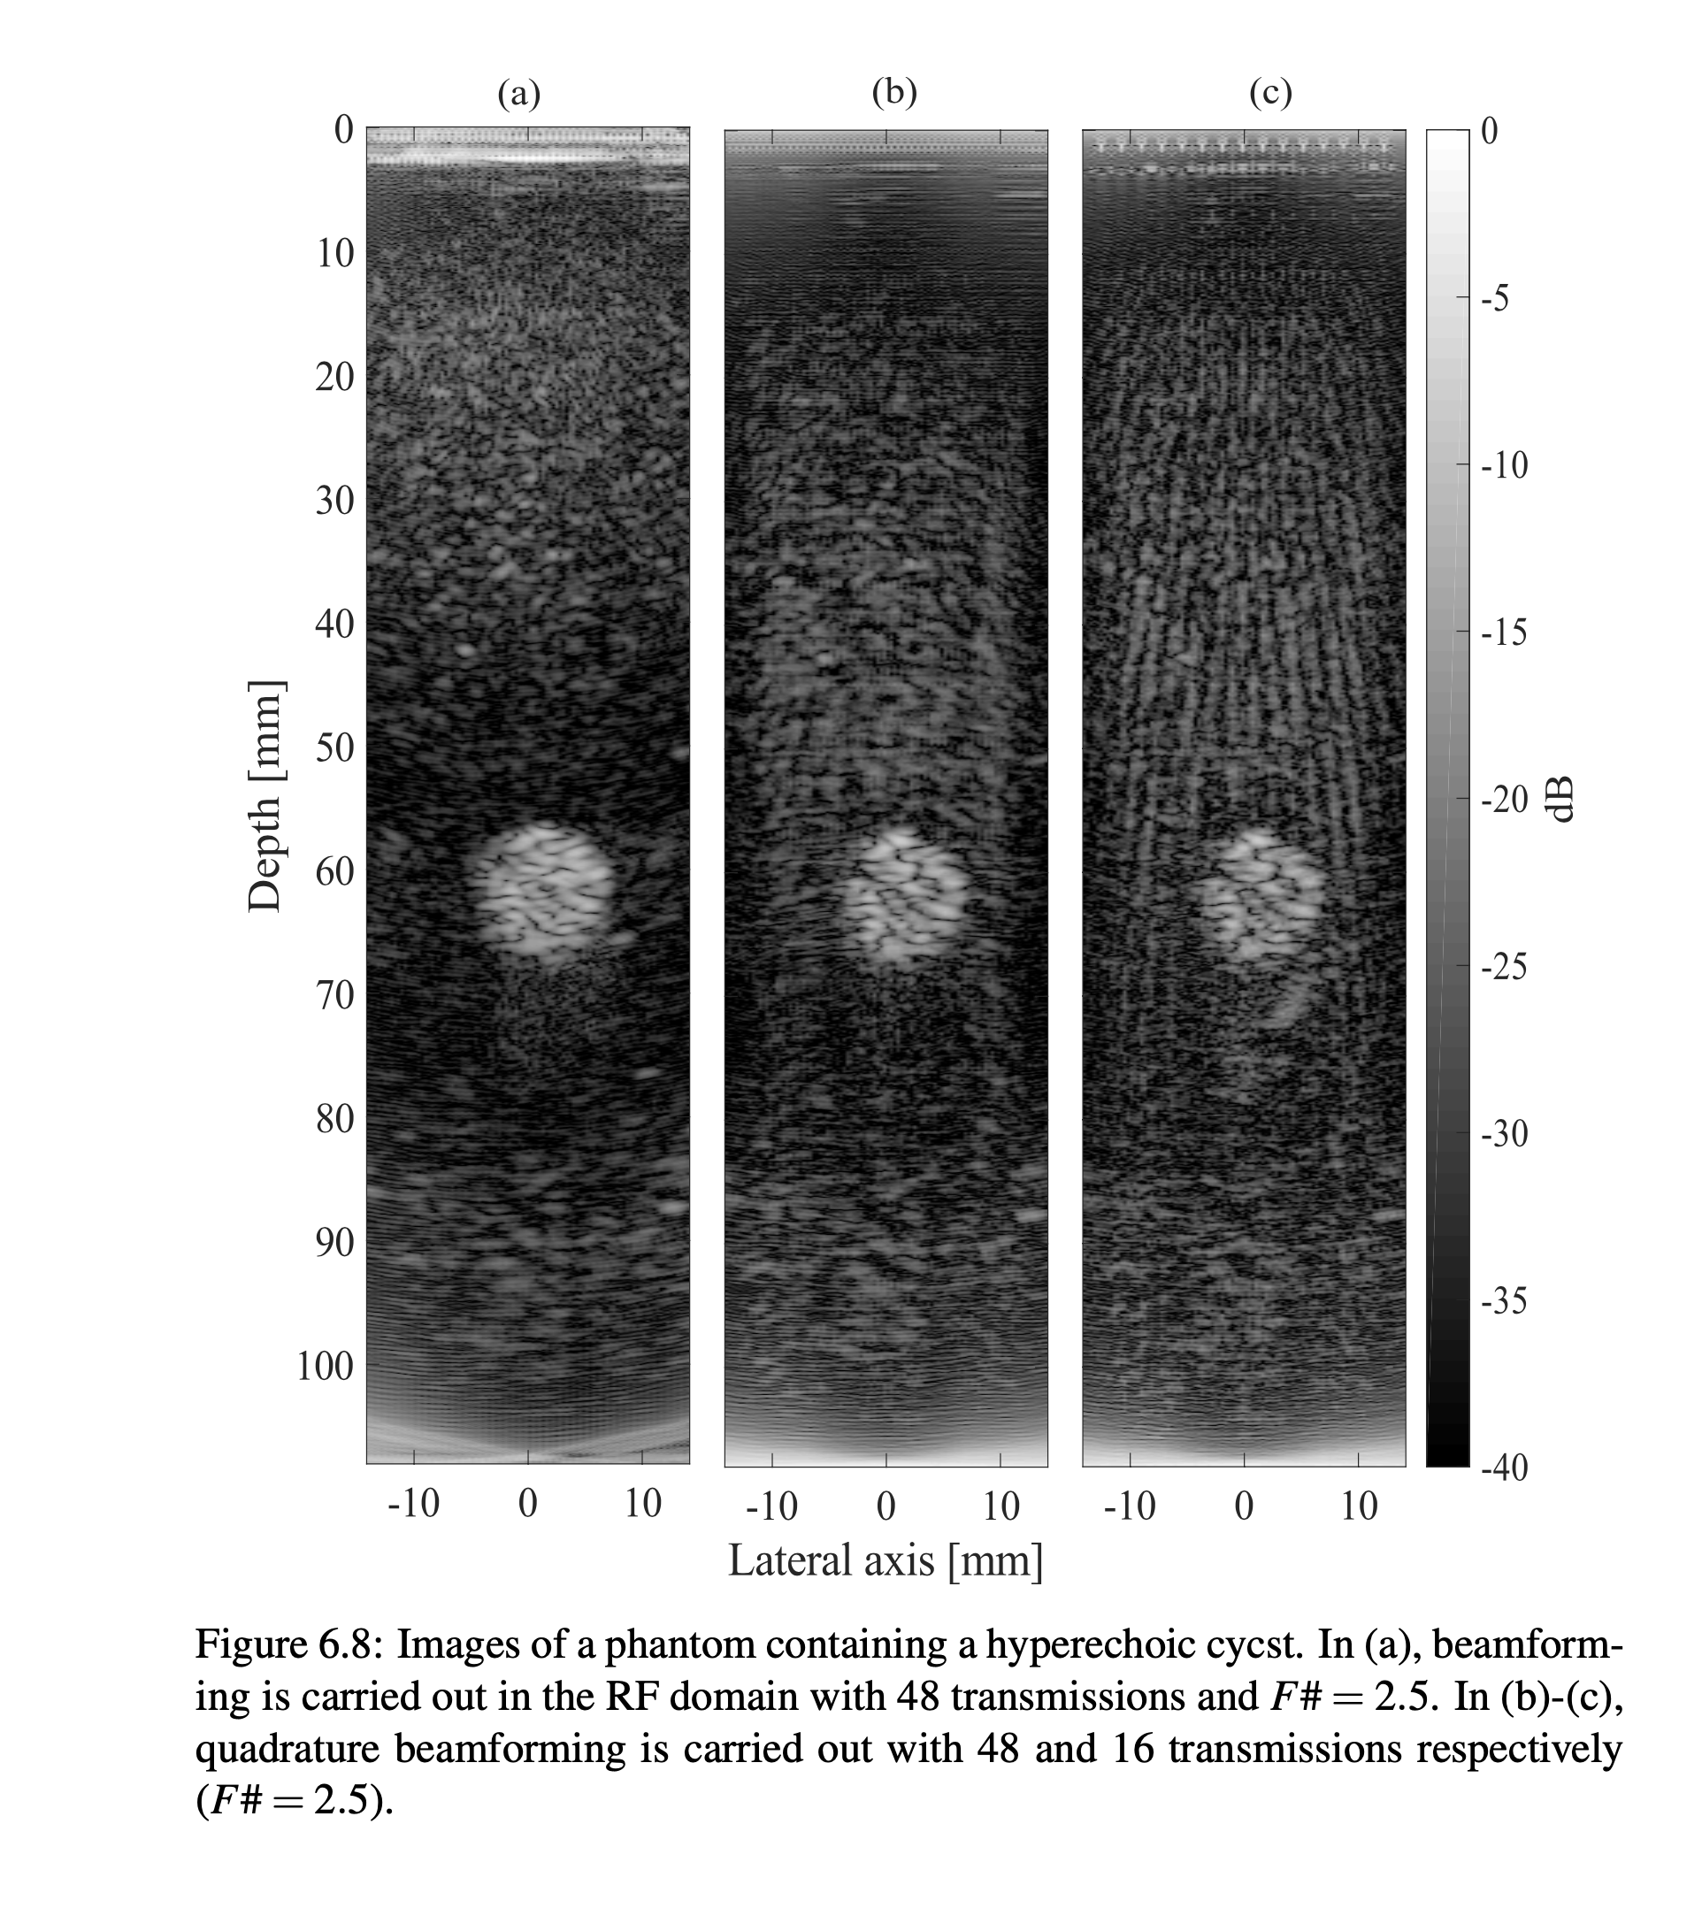
Imaging Results
SNR/resolution limited by #transmits

Slide 9
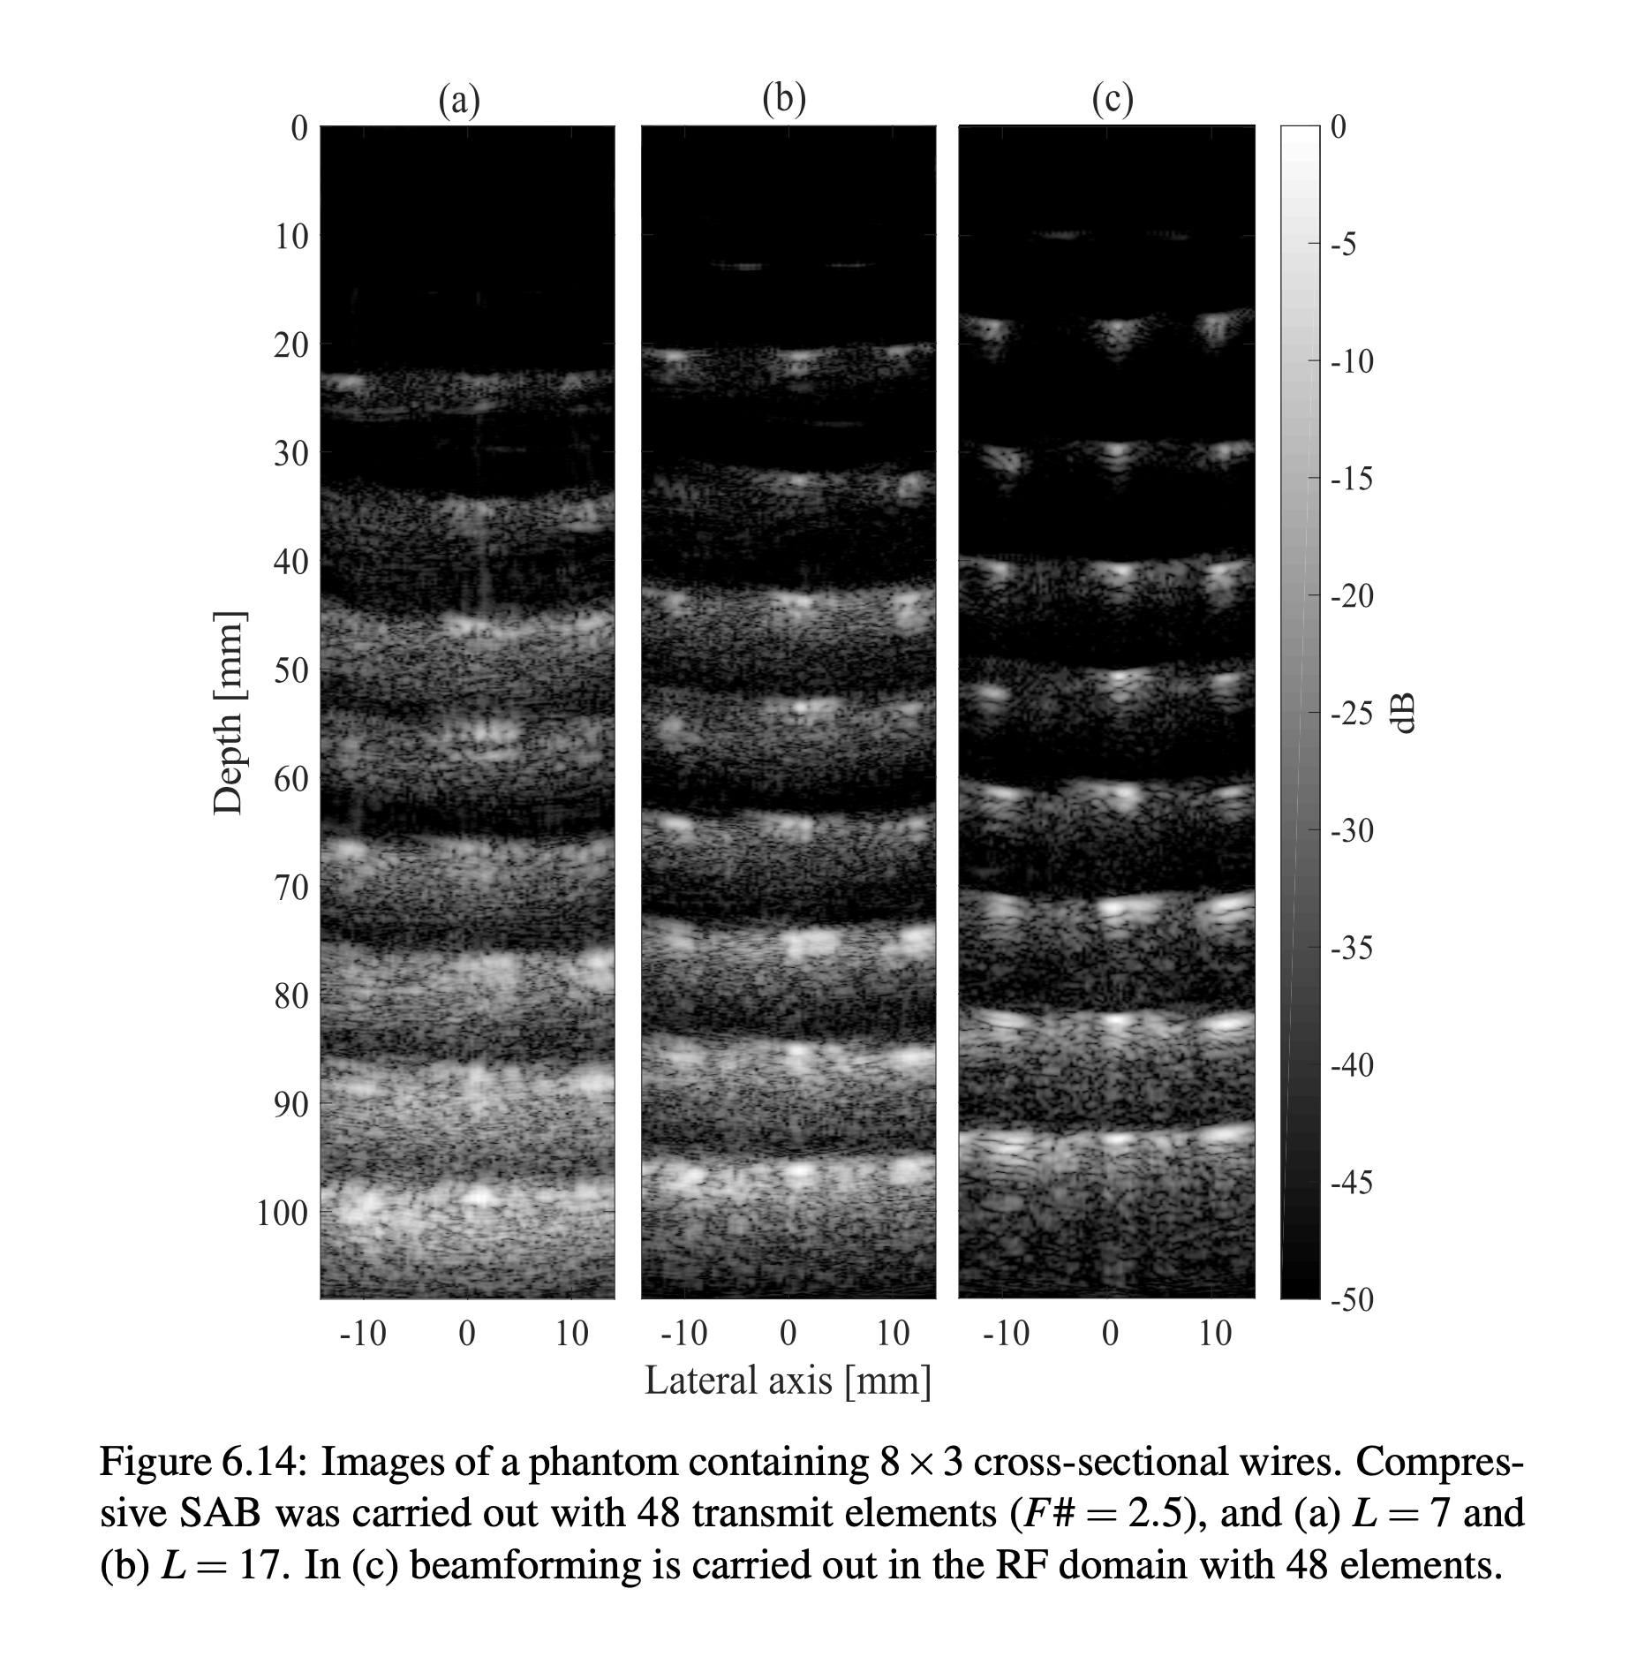
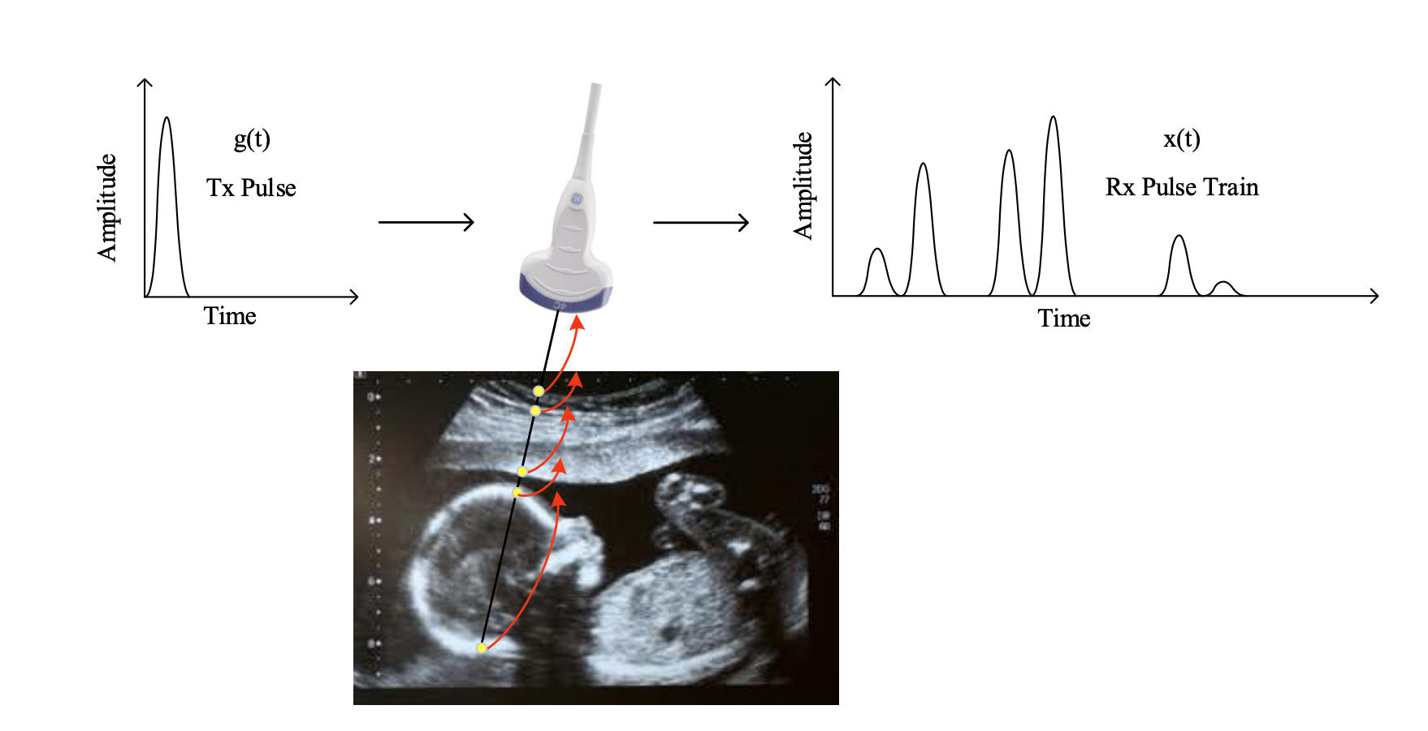
Compressed sensing – FRI signals

Slide 10
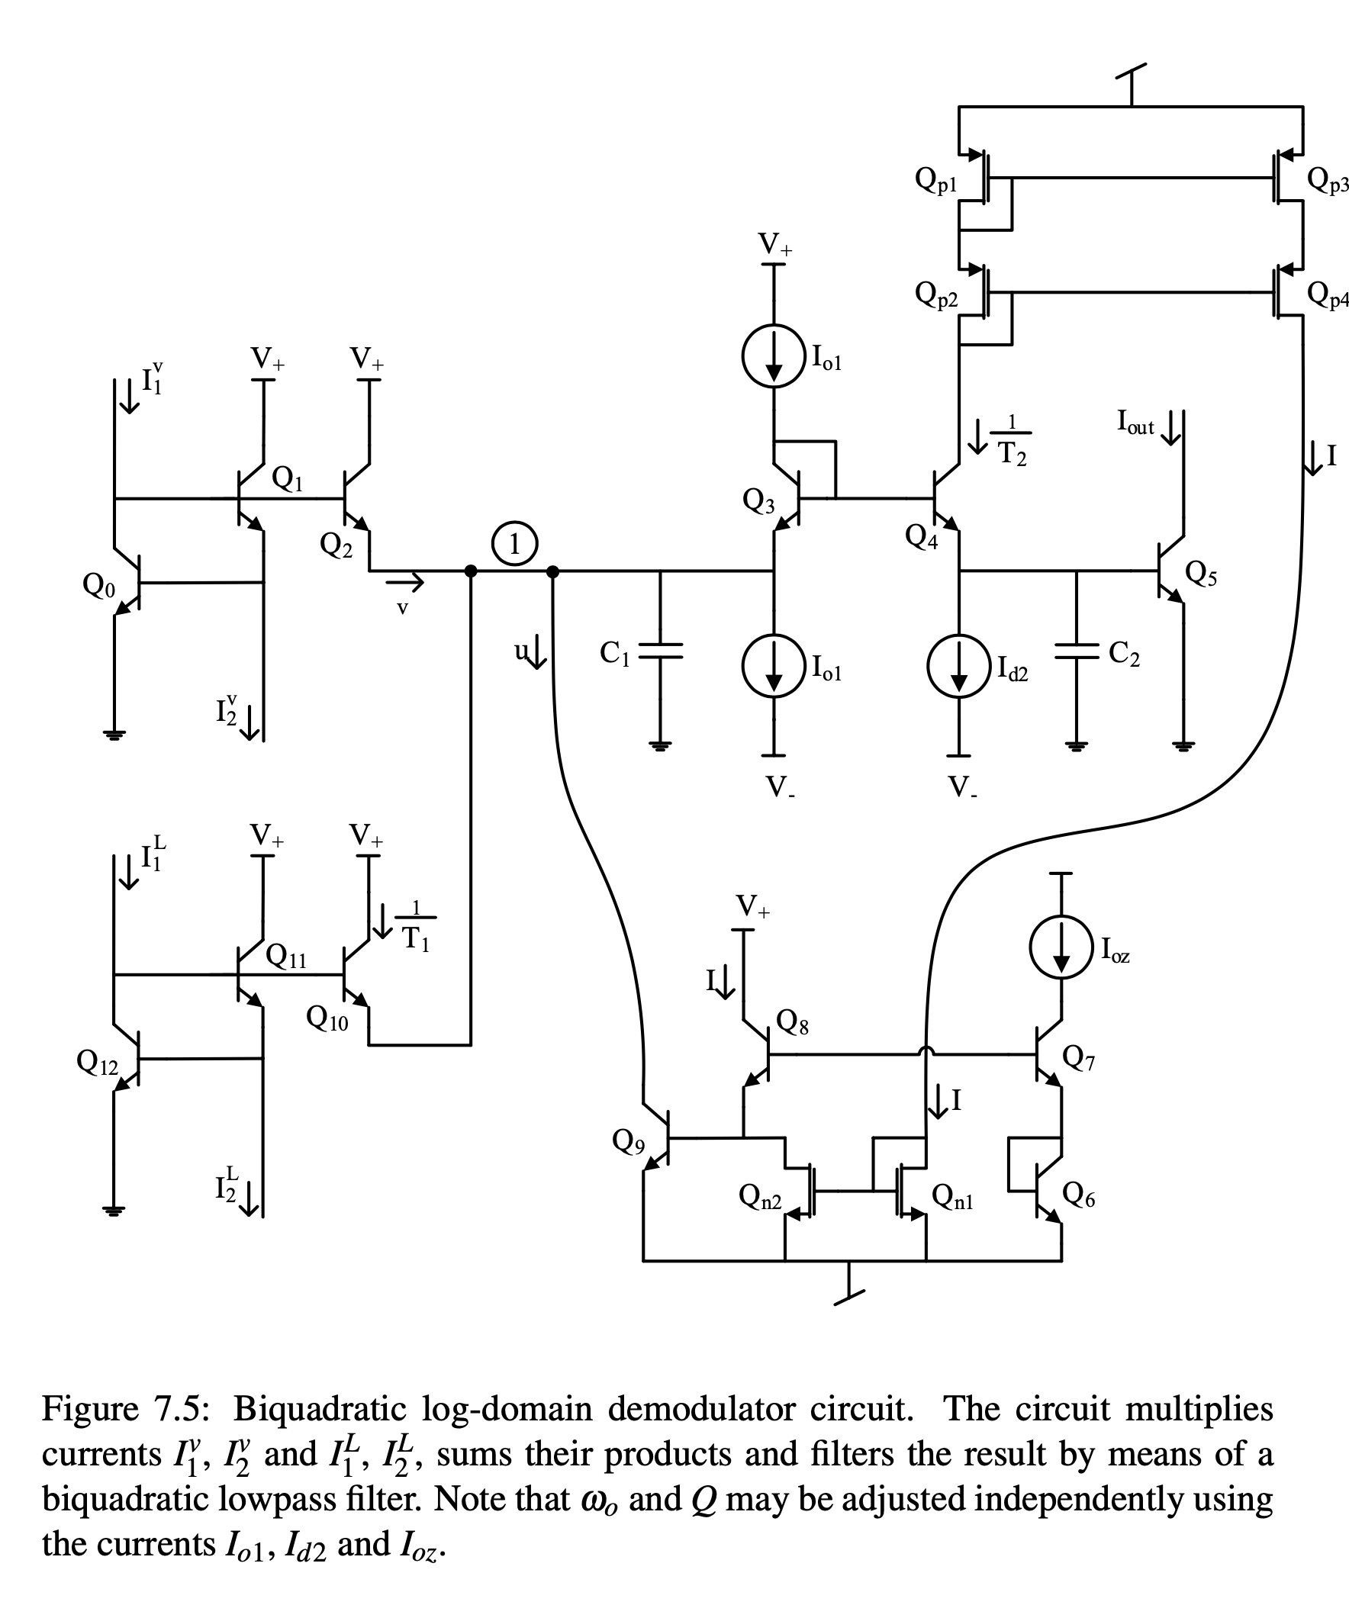
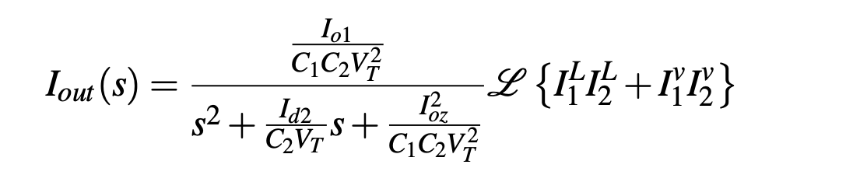
Log-domain in BiCMOS

Slide 11
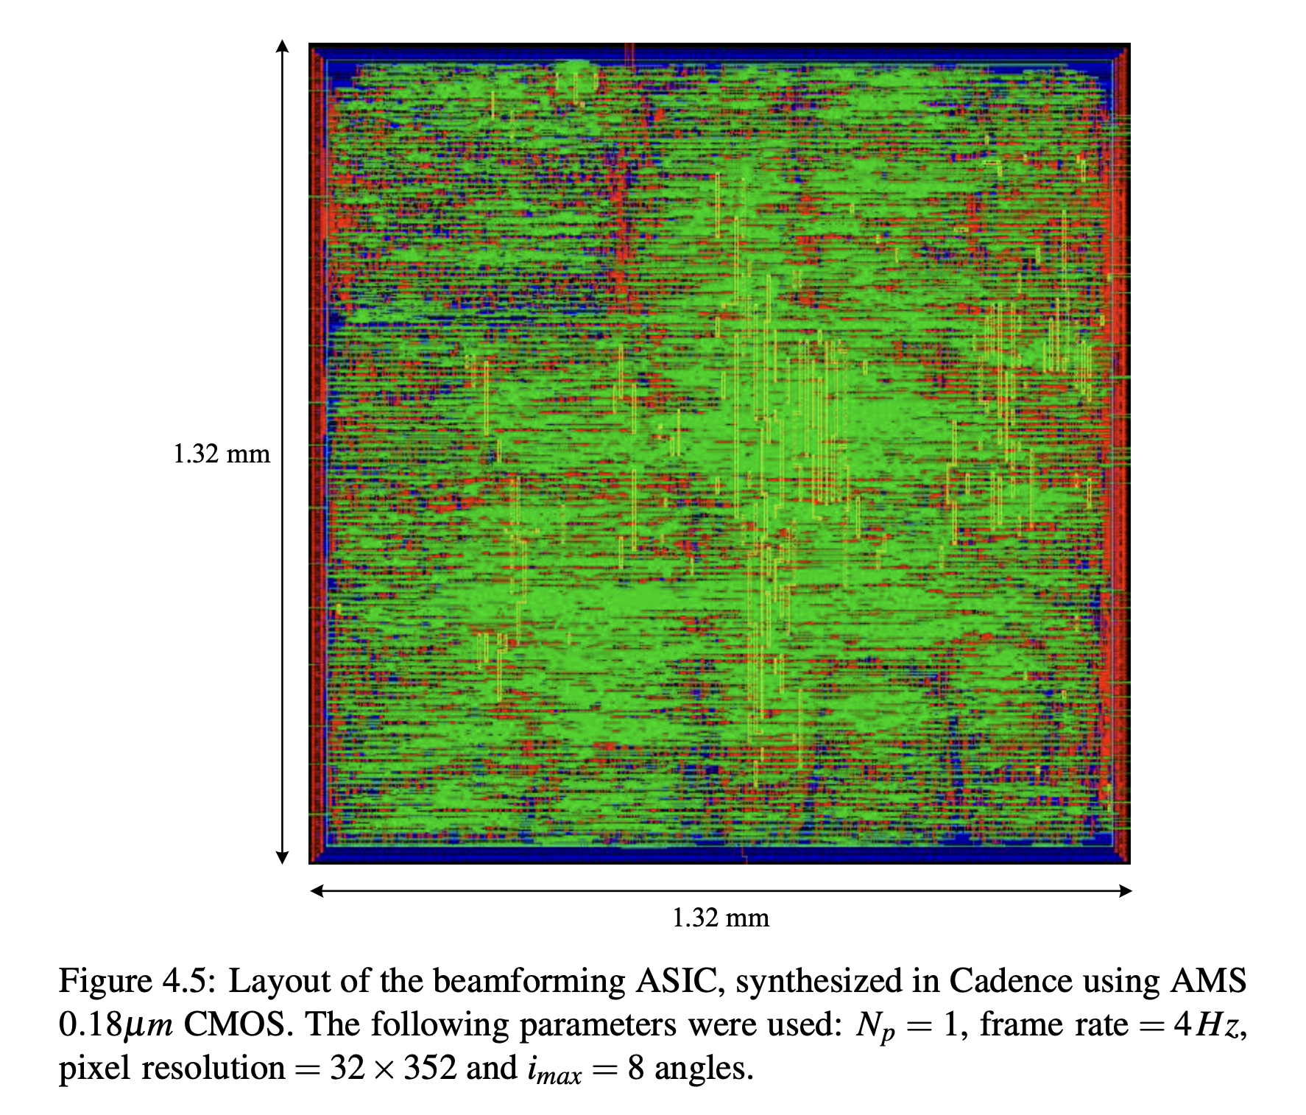
Incomplete
On-chip implementation of beamformer – started synthesis/physical layout, but never taped out.
Integration with transducer, packaging etc.

Slide 12
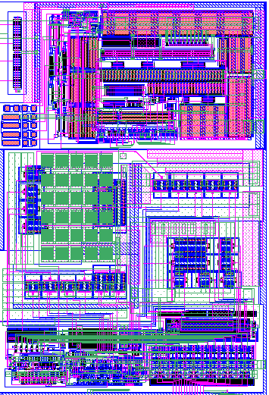

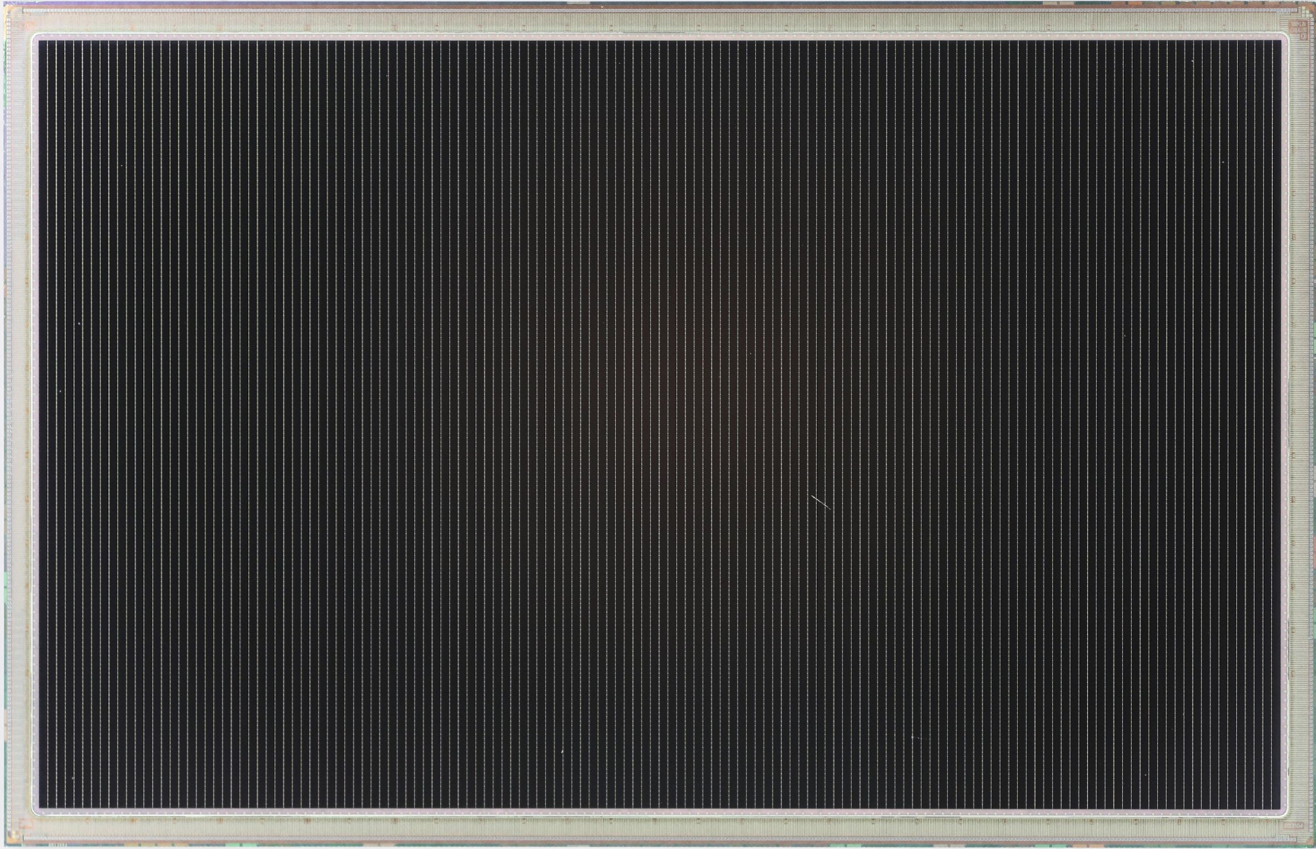
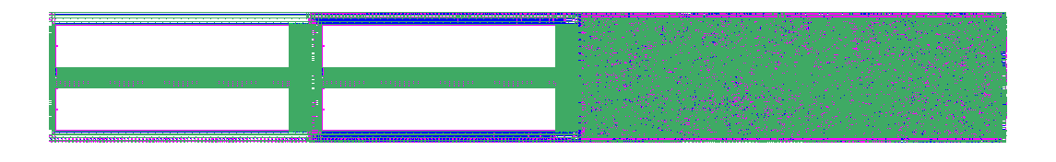
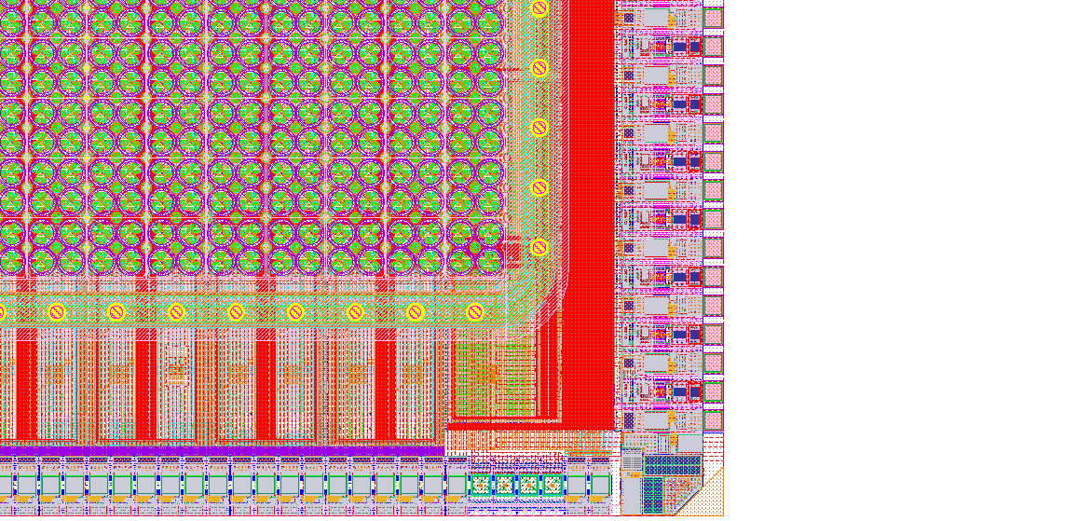
Background
31.0mm
Ultrasound Processing Units
Matrix Array:
Sensor and Analog Front-End
8960 Elements:
Independent Receiver
and Transmitter
20.0mm
Ultrasound Processing Units
140 Ultrasound Processing Units:
Digital Signal Processing
1120 Channels:
Independent ADC
and Gain Control
8960 Individual
Sensor Elements
Notes:
What is the frequency range of operation vs. size relation for CMUT? [NS on CMOS]
Lambda/2 at ~4MHz (enables phased array operation)
Lambda pitch at ~8MHz (enables linear operation)
What is/are your drive voltage/voltages? [NS on CMOS]
Today: Pulser: 40V AC
Today: VBias: ~60V DC
What is the minimum receive signal and the dynamic range of the received signal? [NS on CMOS]
Per CMUT element: 1.6Pa => 4kPa (high gain mode) or 4.3Pa => 31.4kPa (high DR mode) **NS TO FIX**
What is the data rate coming out of the 2D array at full operation? [NS on CMOS]
280Gbps from ADCs
What is the resolution and pitch in x and y for the 2D array? [NS on CMOS]
208um pitch for both dimensions.
What is the main benefit for you for using a 2D array instead of a linear array? [NS on CMOS]
Universal Probe! Configurable aperture size, elevational beamforming.
(Bonus: low frame rate 3D)

Slide 13
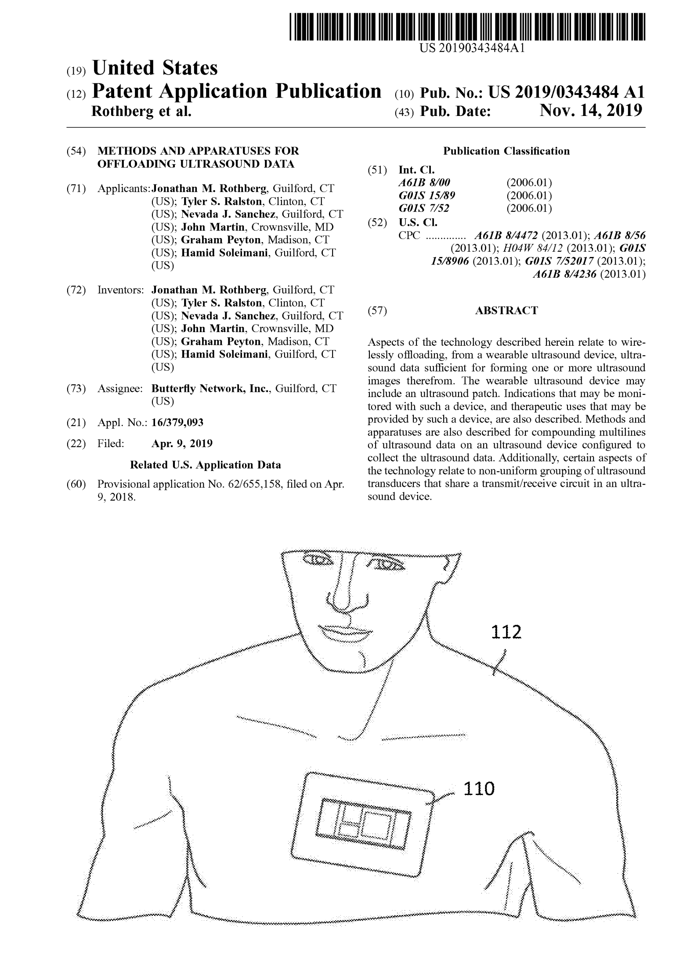
Initial Contributions
Started out designing BIST circuitry for existing AFE
Helped with optimization of transmitter circuitry
Developed a few patents on new data processing/beamforming techniques targeting wireless, covering hardware, algorithms and software – see scholar

Slide 14
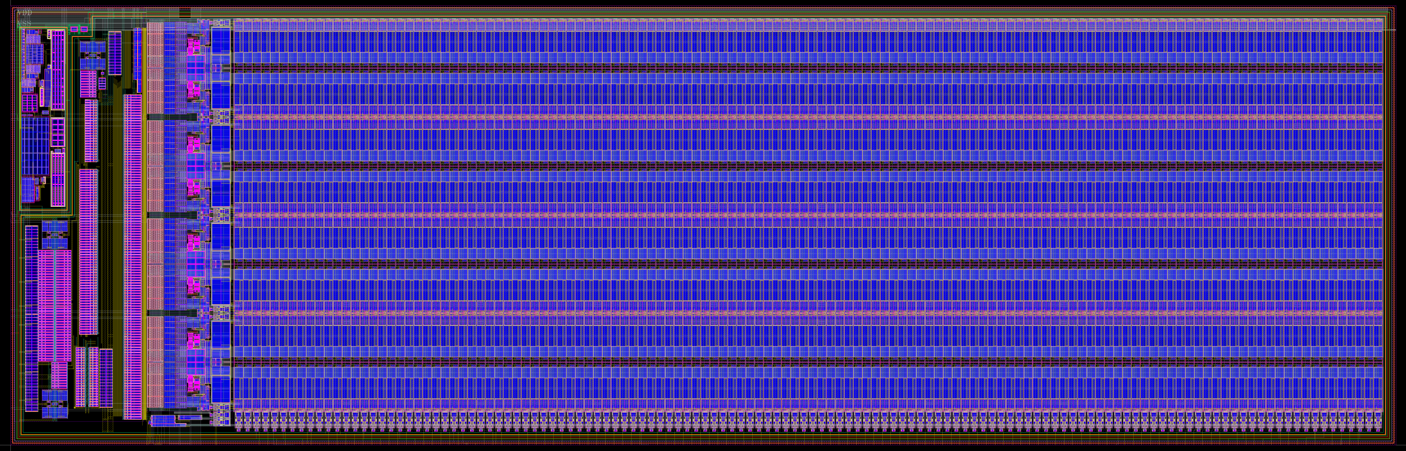
Non-volatile memory

Slide 15
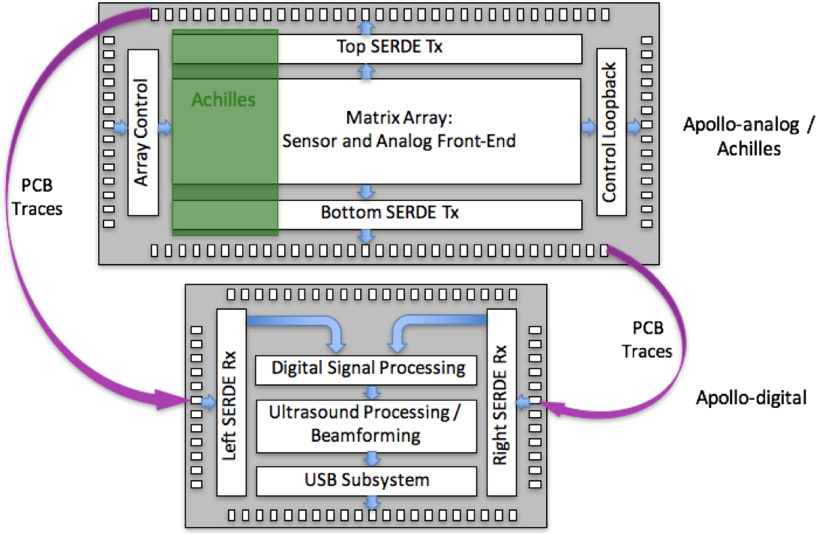
Next-gen architecture – SerDes

Slide 16
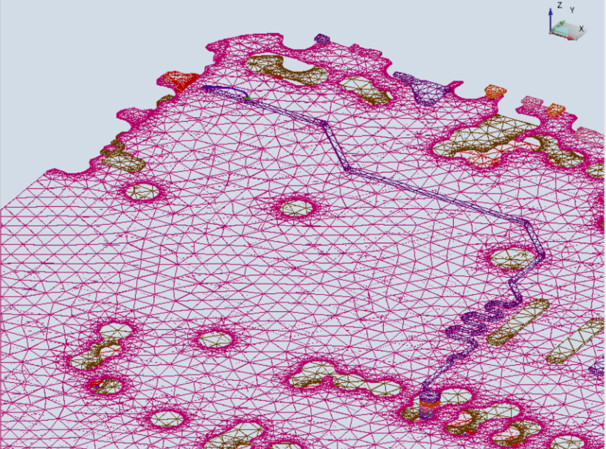
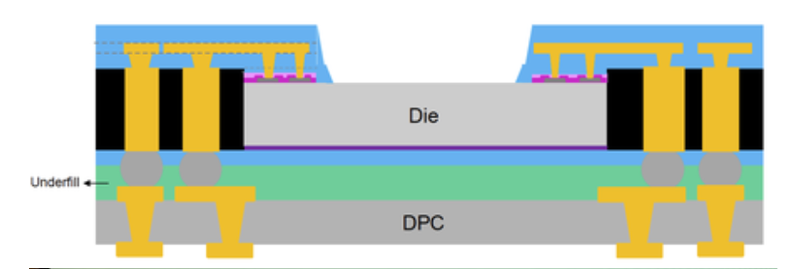
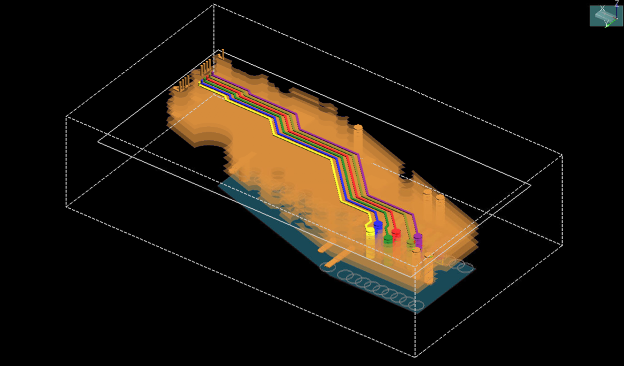
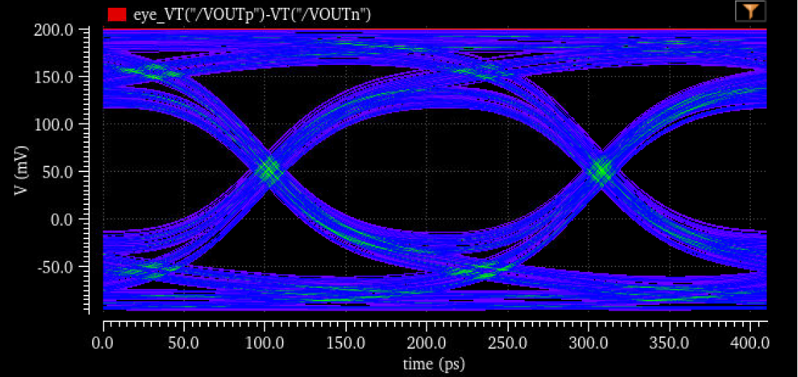
SI/PI, modeling, package design, etc

Slide 17
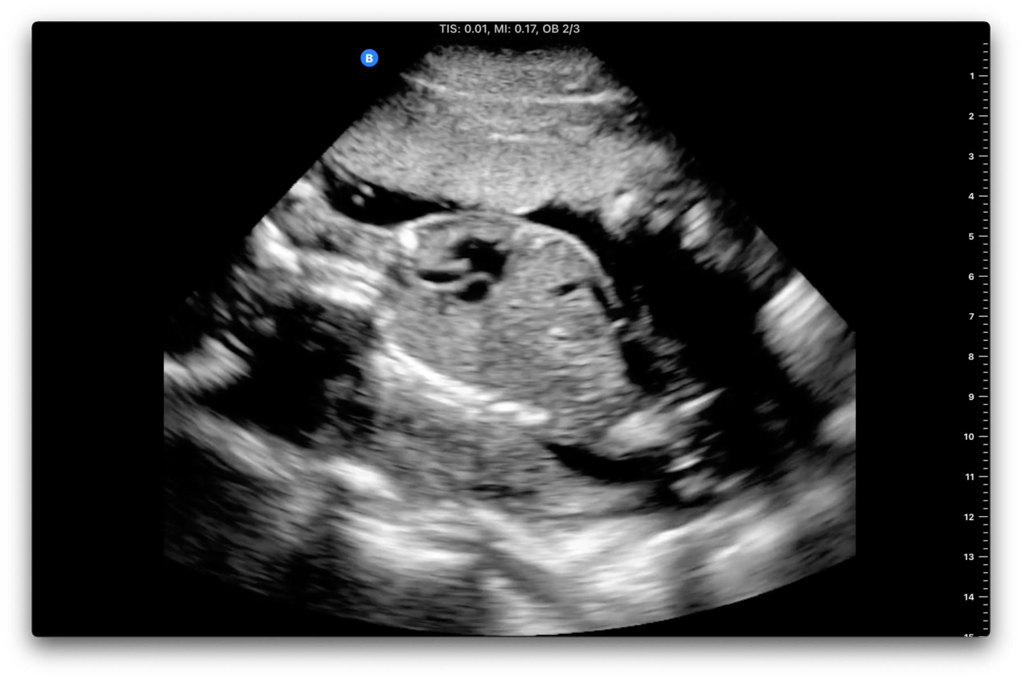
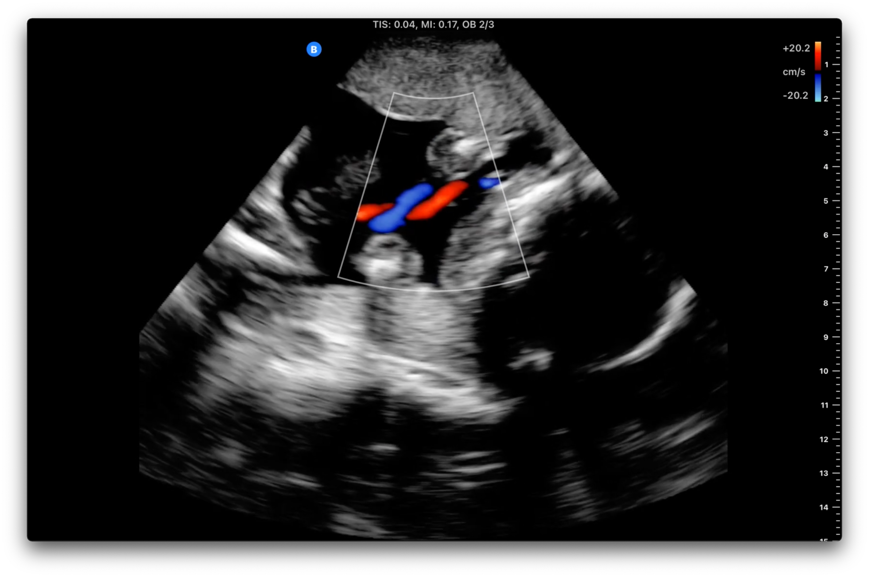
Imaging – color doppler
Mostly Python, C++

Slide 18
Liminal – key contributions
Team lead on all things HW
Technical contributions
Designed entire architecture – full ultrasound AFE, FPGA beamformer, imaging / AI backend, comms link, etc
Designed 90% of schematic, handed over layout to full time EE
Imaging/SW: ported color flow pipeline from Python → GPU in C++, performed benchmark tests.
Bringup, verification, EMI/EMC testing, 60601 conformance
Key contributor + support for thermal / housing solution
Manufacturing / NPI → liaison with planned manufacturer
Hired/managed 2 full-time employees (senior EE, principal EE), and 2 consultants (FPGA, EE)
Love working at the intersection between all technical domains

